Slide 1
Isotopes.au Team Meeting
CSIRO & ANSTO & GA & Lithodat

Slide 2
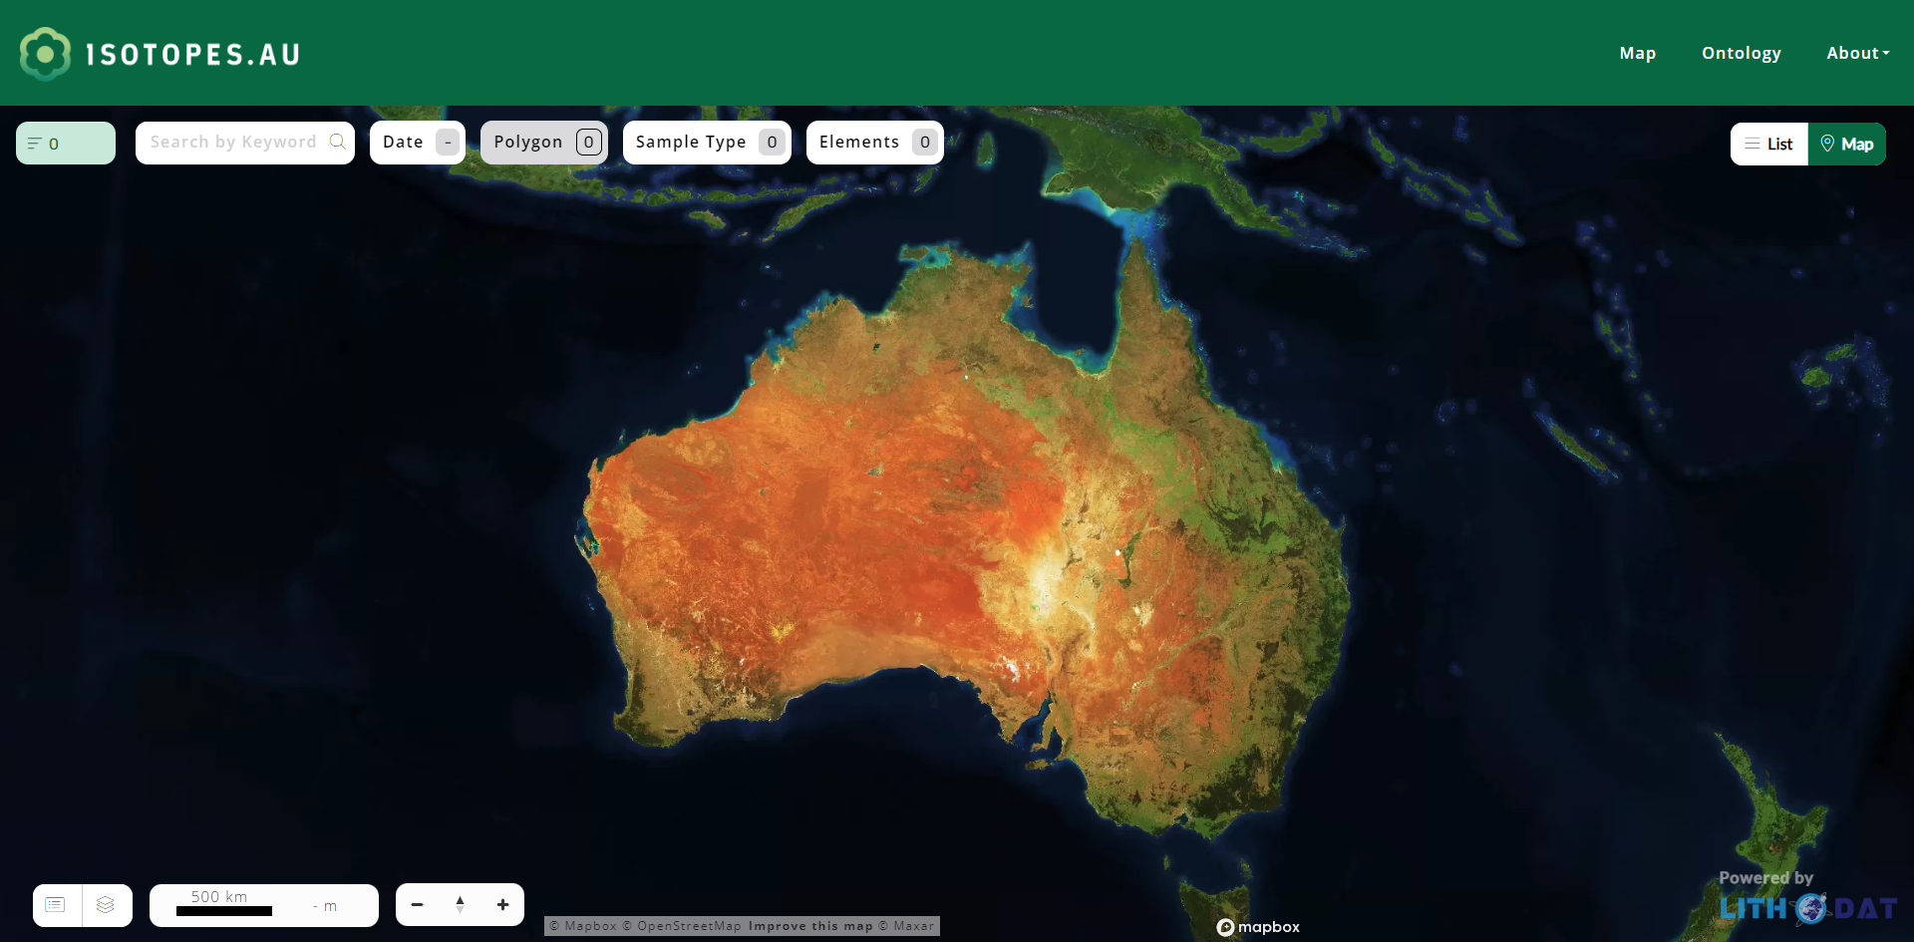
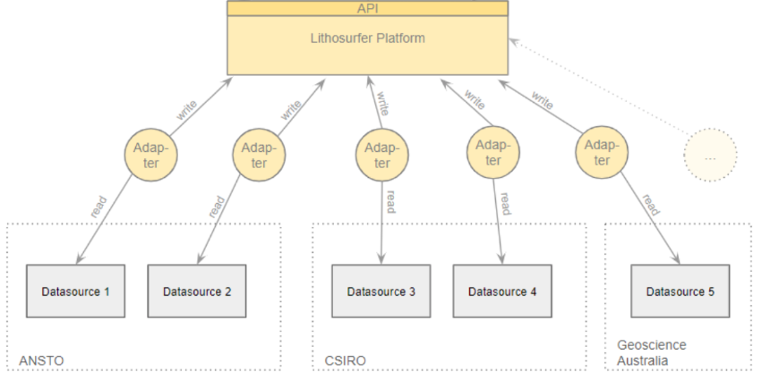
Working Model & Adapters is Basis for UI
UI
Model & Adapters
This presentation focuses on the Model & Adapter development

Slide 3
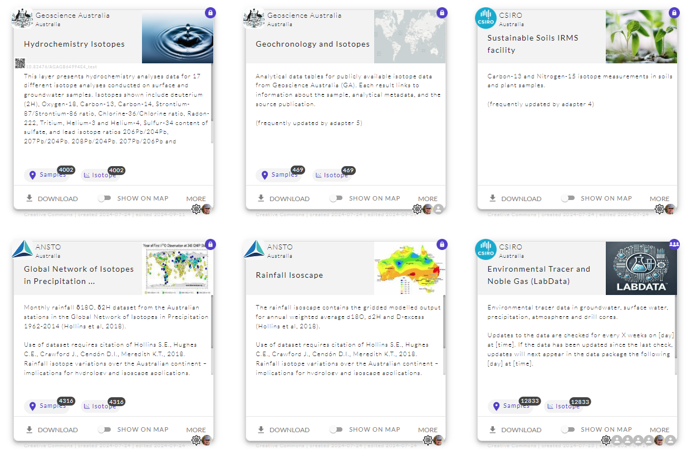
Current State of Adapters
This one is next.
Technically Working
Ready for Production
This one is new since last time.

Slide 4
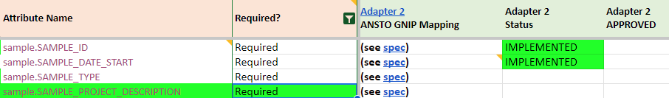
Definition of “Ready for Production”
All required fields need to have been approved by an expert.
Ontology definition sheet
Not approved yet.

Slide 5
How to Approve
To approve a field mapping the proprietary input data has to be checked against the output data in common ontology format.

Slide 6

How to Approve
To approve a field mapping the proprietary input data has to be checked against the output data in common ontology format.
The proprietary input data gets translated (aka. mapped).
Ansto.proprietary.xls

Slide 7
How to Approve
To approve a field mapping the proprietary input data has to be checked against the output data in common ontology format.
CLICK on DOWNLOAD
Ansto.ontology.xls
The data get’s exported in the format of the common ontology.
Ansto.proprietary.xls

Slide 8

How to Approve
To approve a field mapping the proprietary input data has to be checked against the output data in common ontology format.
But how can the data be checked?
Ansto.ontology.xls
Ansto.proprietary.xls

Slide 9
How to Approve
To approve a field mapping the proprietary input data has to be checked against the output data in common ontology format.
How to check the mappings:
Download the latest ontology.xls of your adapter.
Pick a random row from your proprietary.xls
Find the corresponding row in the ontology.xls.
Check the mappings.
Repeat with other row if unsure.
Update ontology definition sheet
Ansto.ontology.xls
Ansto.proprietary.xls

Slide 10
Definition of “Ready for Production”
All required fields need to have been approved by an expert.
by Cath
by Cath
Ontology definition sheet
Leave a comment instead of your name in case the mapping is not as expected.

Slide 11
Enable filtering by type on the UI

Slide 12
Full Cycle
To approve a field mapping the proprietary input data has to be checked against the output data in common ontology format.
The data get’s exported in the format of the common ontology.
CLICK on DOWNLOAD
Ansto.ontology.xls
The proprietary input data gets translated (aka. mapped).
Ansto.proprietary.xls

Slide 13
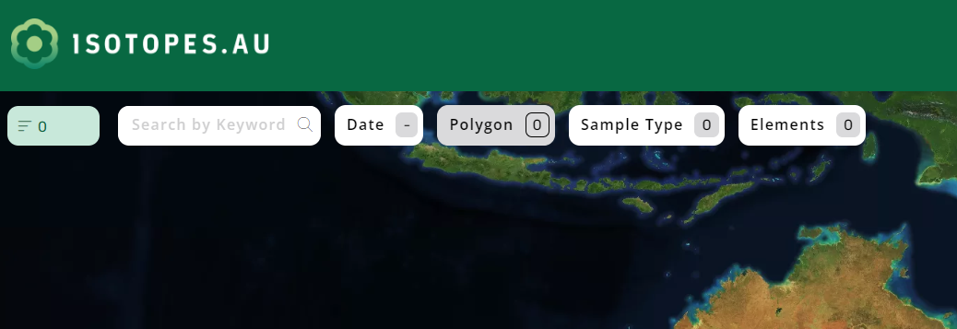
Overview of filters
!

Slide 14
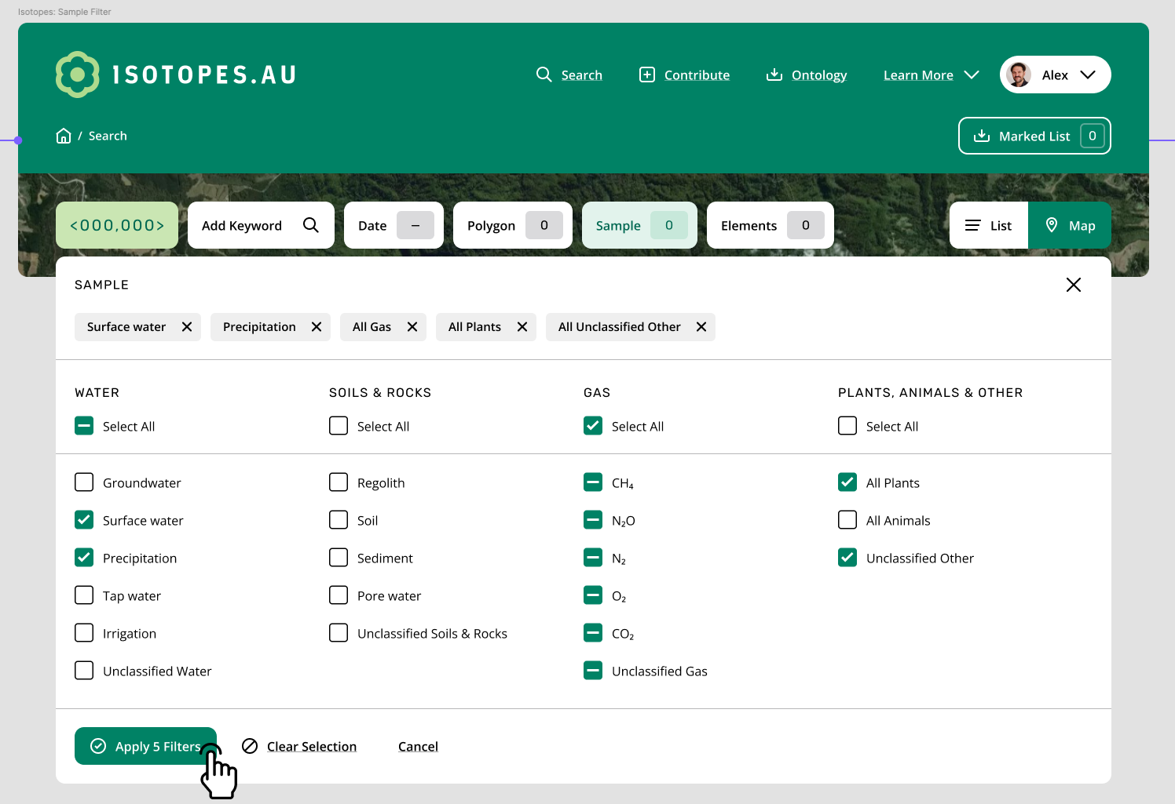
UI as specified by CSIRO (2024-09-16)
See concept

Slide 15
Thanks!

Slide 16
Main Goal of Today’s Meeting:
Understanding the Adapter Development Process
The adapters need to implement a lot of expert knowledge. Next slides will show with a concrete example how the knowledge can be transferred from the experts to the developers.

Slide 17

Overview
isotopes.au ontology
Speci- fication

Slide 18
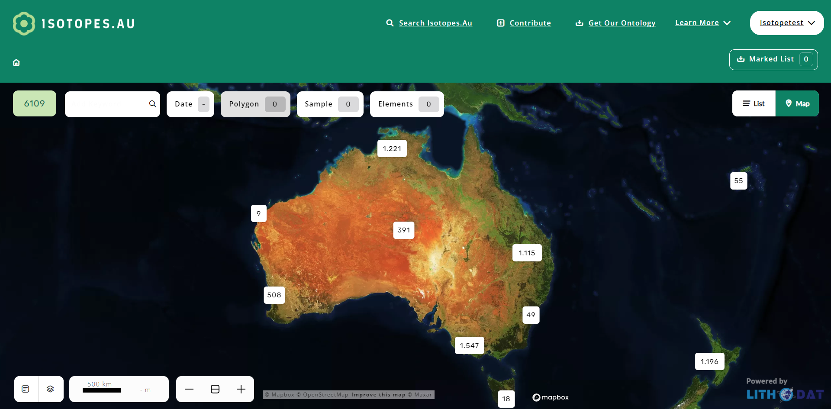
Speci- fication

Slide 19
Overview
Speci- fication
Technicals
Mappings

Slide 20

Overview
reads
Speci- fication
Coder
implements
Coder releases version when finished.

Slide 21

isotopes.au ontology
updates
compares
Speci- fication
Expert

Slide 22


isotopes.au ontology
updates
compares
Speci- fication
Expert
reports issue
Lian F.
Bug-
tracker

Slide 23
Overview
reads
Speci- fication
Coder
implements
reads
Bug-
tracker

Slide 24
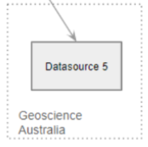
Let’s Exercise an Expert Feedback Round
What the expert needs:
Expert
isotopes.au ontology
output
Speci- fication

Slide 25
Let’s Exercise an Expert Feedback Round
How to update the spec:
feedback
Lian
edits
Expert
comments
isotopes.au ontology
output
Speci- fication

Slide 26
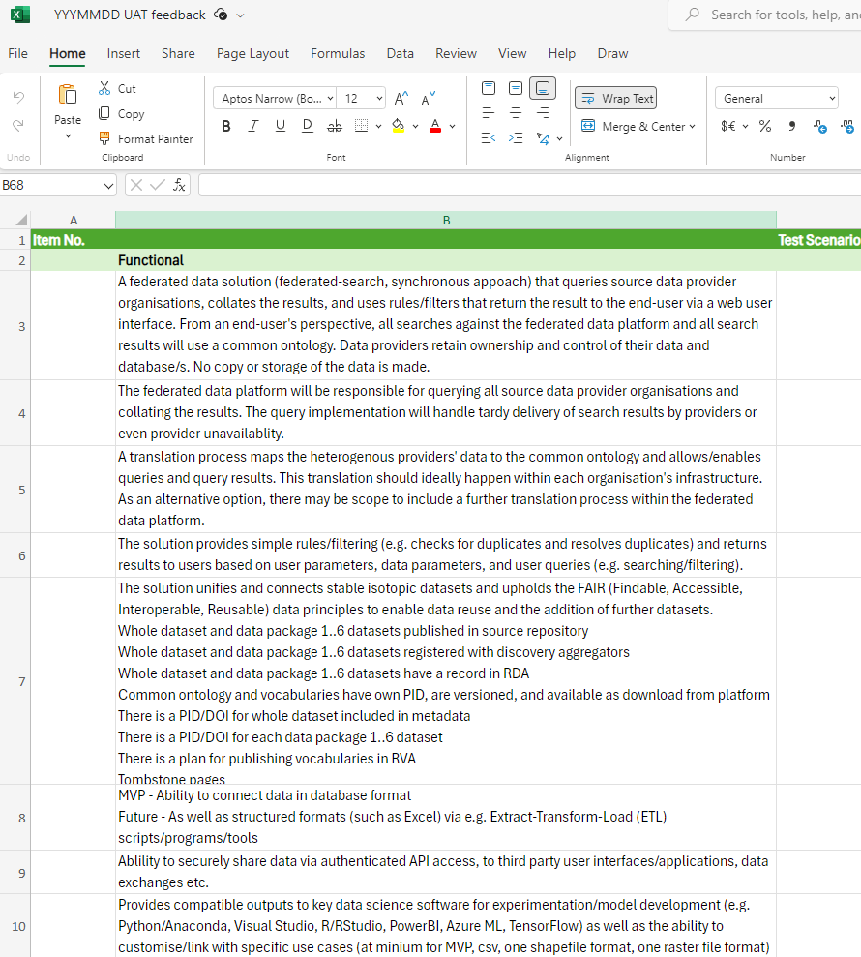
Feedback Formular

Slide 27
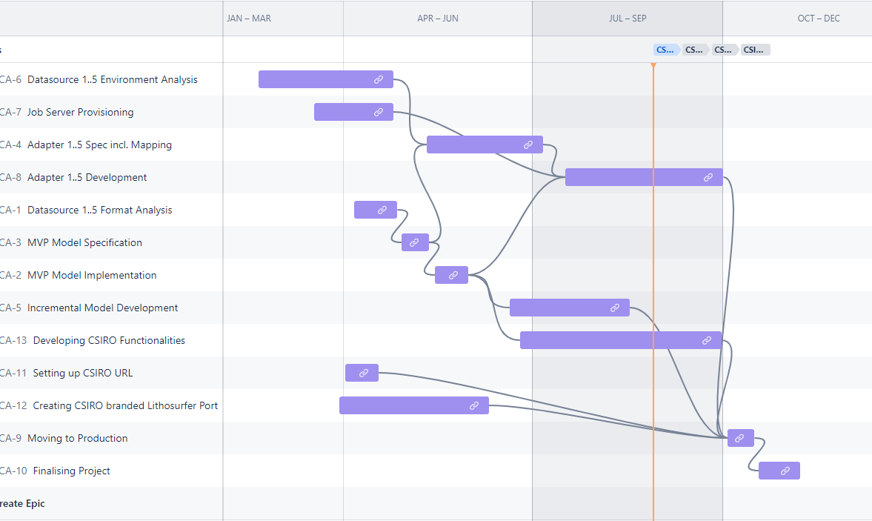
Lithodat internal Timeline
Adapter 3
A. 5
A. 6
A. 2
A. 4
A. 1

Slide 28
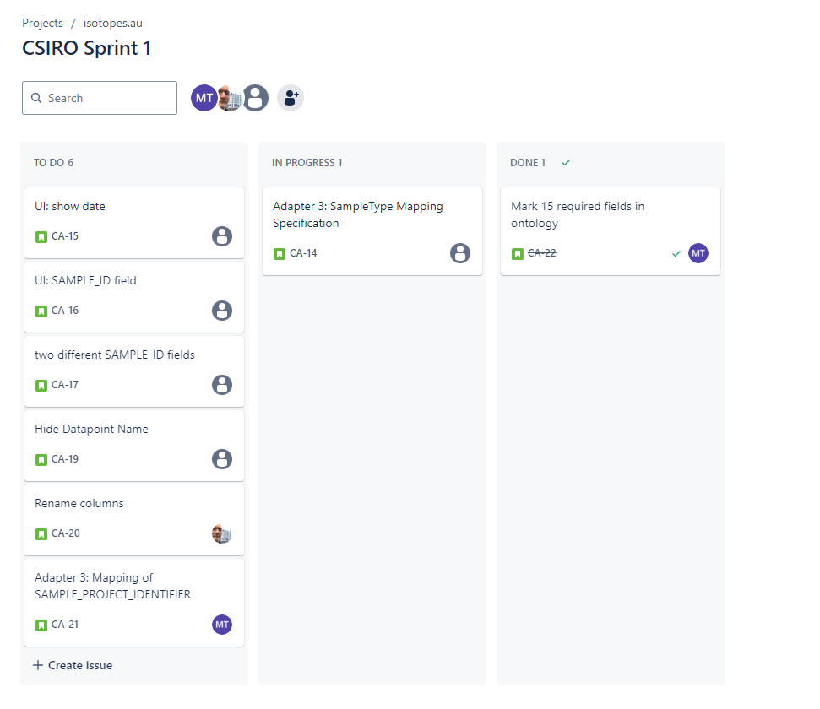
All Feedback and Issues can be managed in Jira

Slide 29
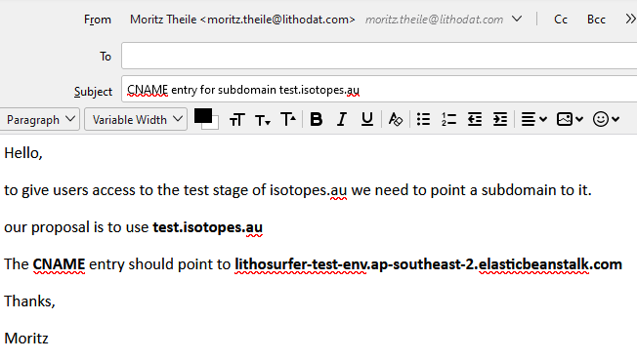
Send Mails with instructions
Who are the recipients?

